Slide 1

Computer Organization 2
Lab tutorial 3
Chapter (3)

Slide 2
Agenda Chapter (3) Data Representation
Data Type
Complements
Fixed-Point Representation
Floating-Point Representation
Other Binary Codes
Error Detection Codes

Slide 3
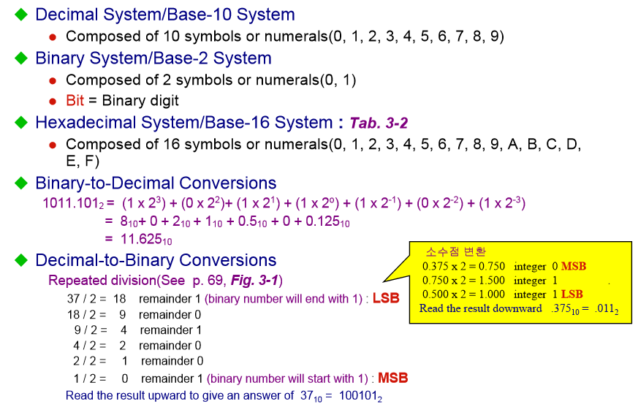
3-1 Data Types

Slide 4
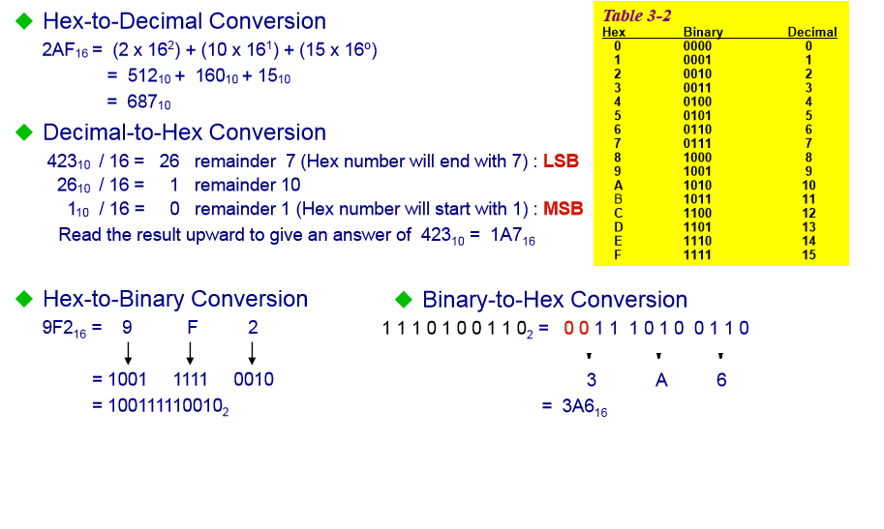
3-1 Data Types

Slide 5
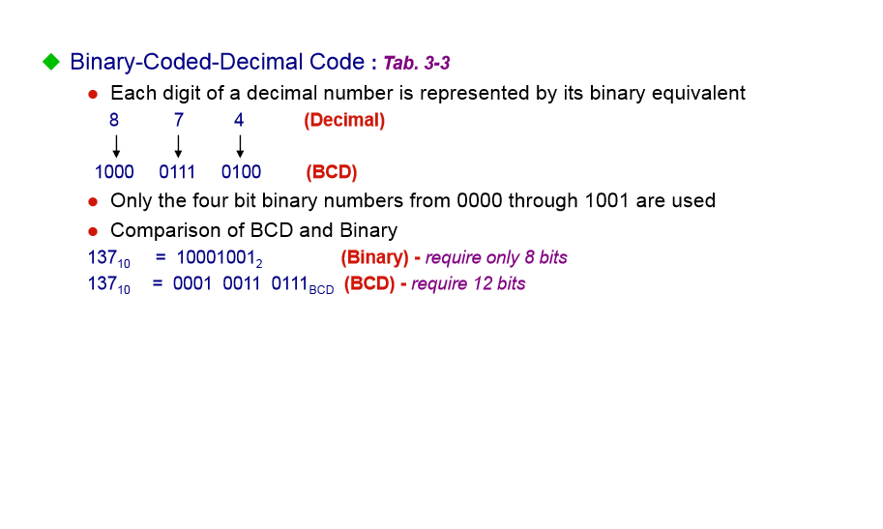
3-1 Data Types

Slide 6
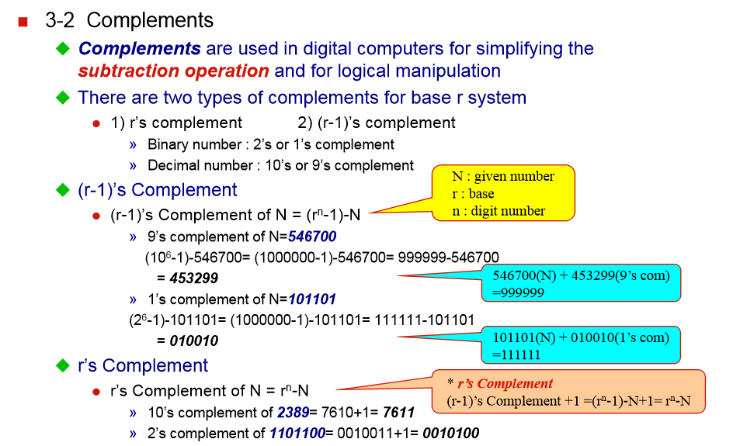
3-2 Complements

Slide 7
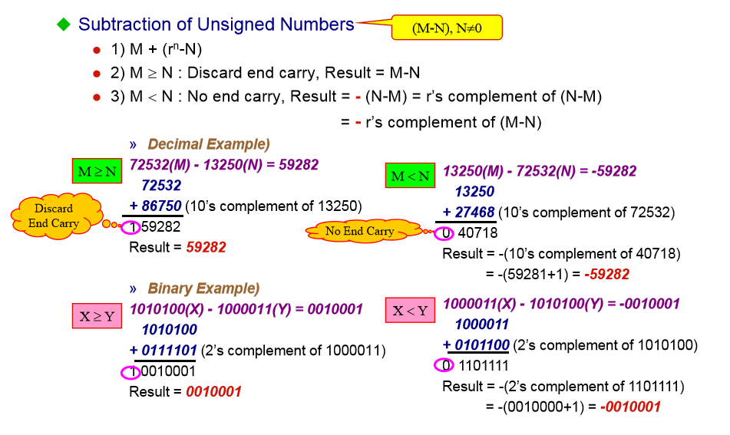
3-2 Complements

Slide 8
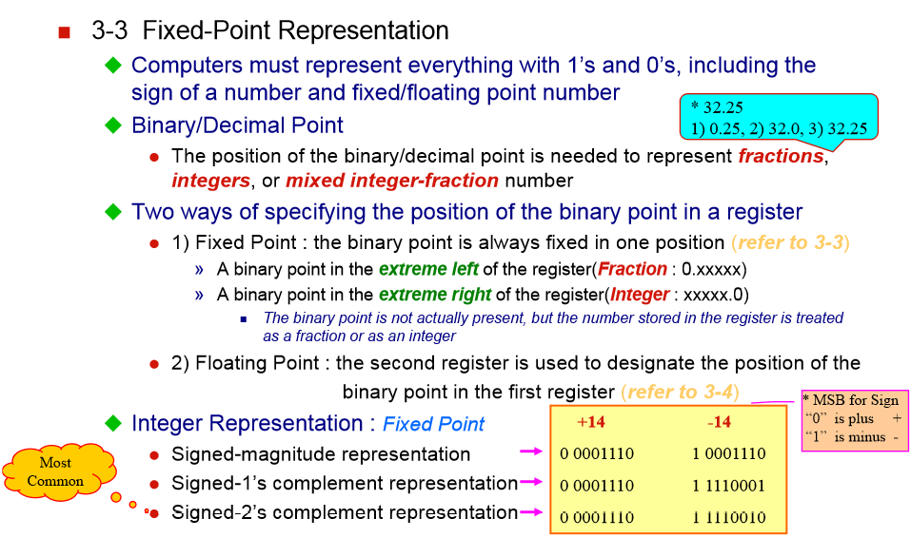
3-3 Fixed-Point Representation

Slide 9
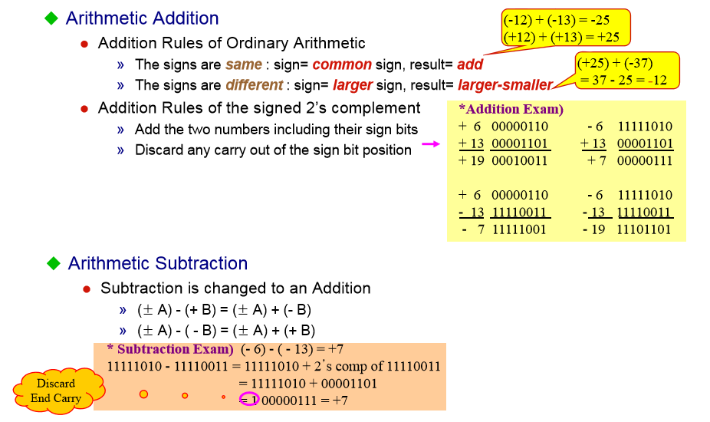
3-3 Fixed-Point Representation

Slide 10
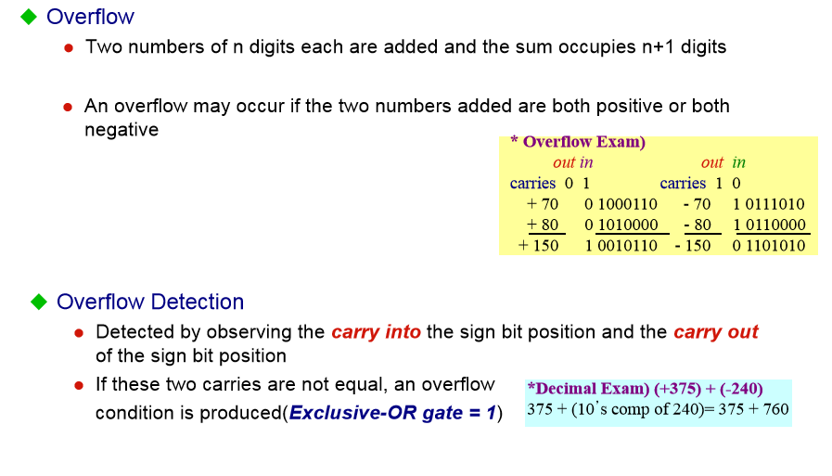
3-3 Fixed-Point Representation

Slide 11
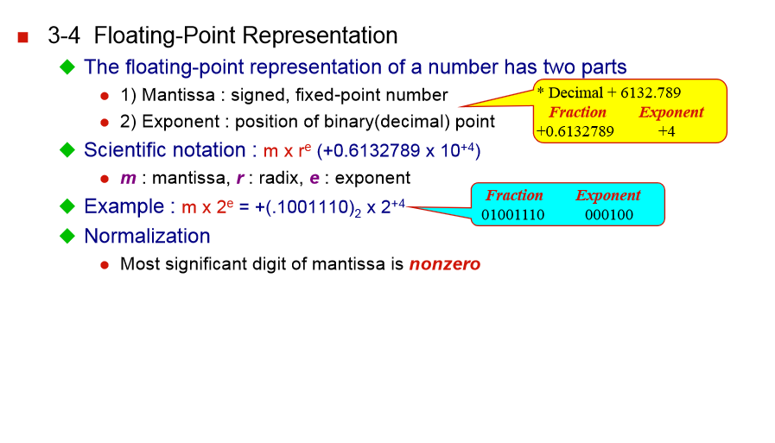
3-4 Floating-Point Representation

Slide 12
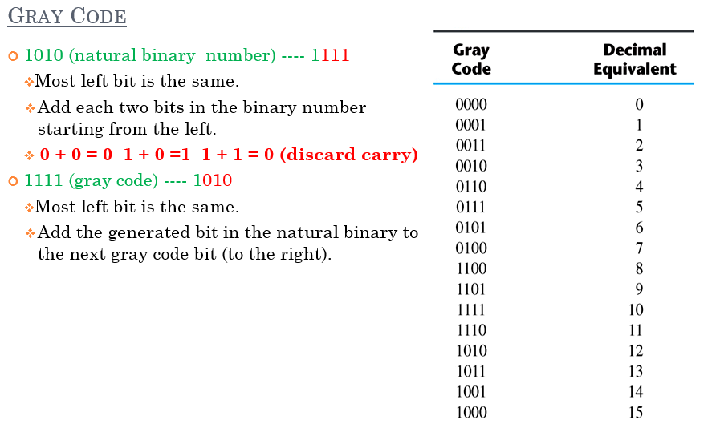
3-5 Other Binary Codes

Slide 13
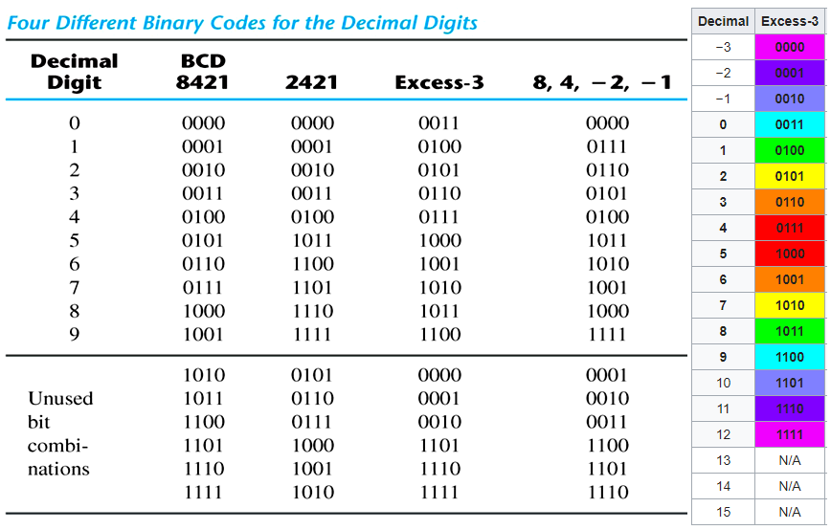
3-5 Other Binary Codes

Slide 14
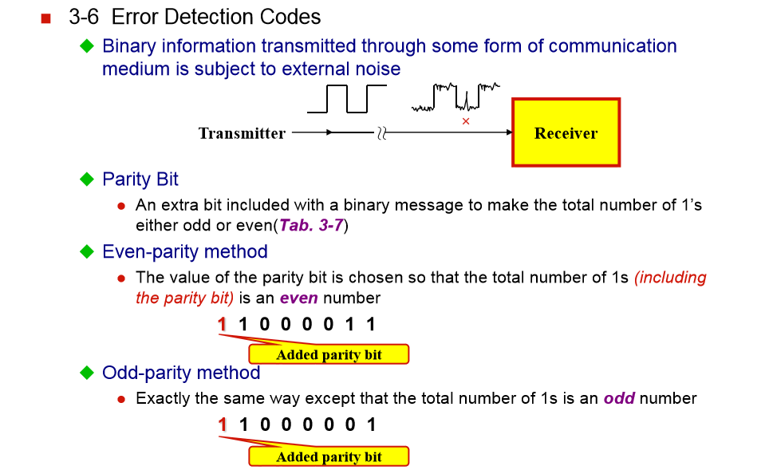
3-6 Error Detection Codes

Slide 15
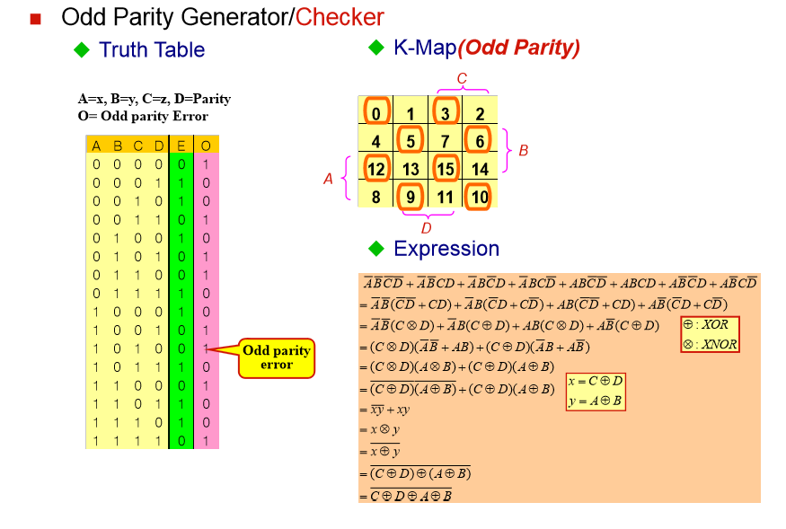
3-6 Error Detection Codes

Slide 16

Problems

Slide 17
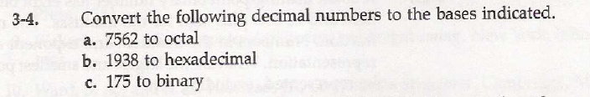

Slide 18
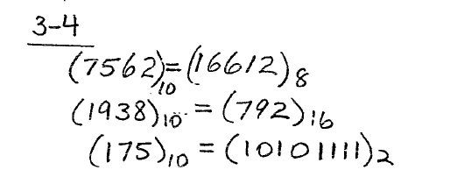

Slide 19


Slide 20
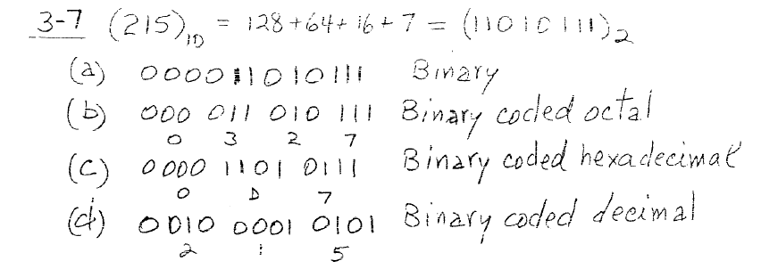

Slide 22
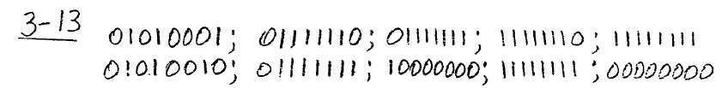

Slide 23


Slide 24
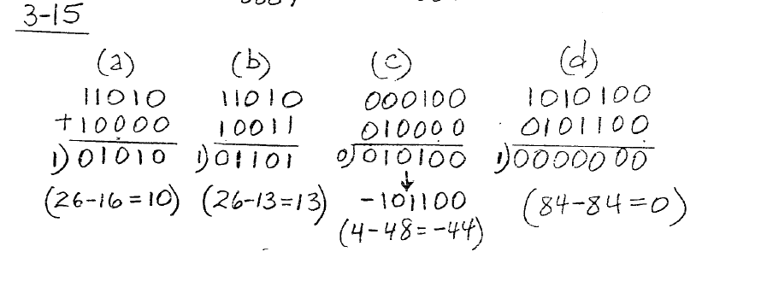

Slide 26
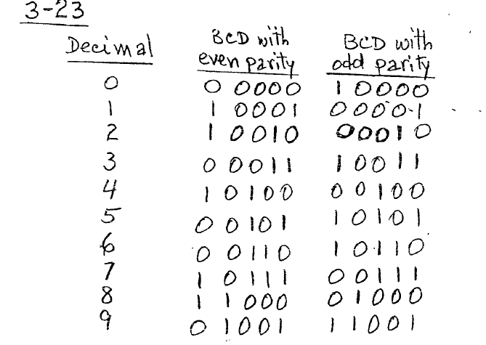

Slide 27
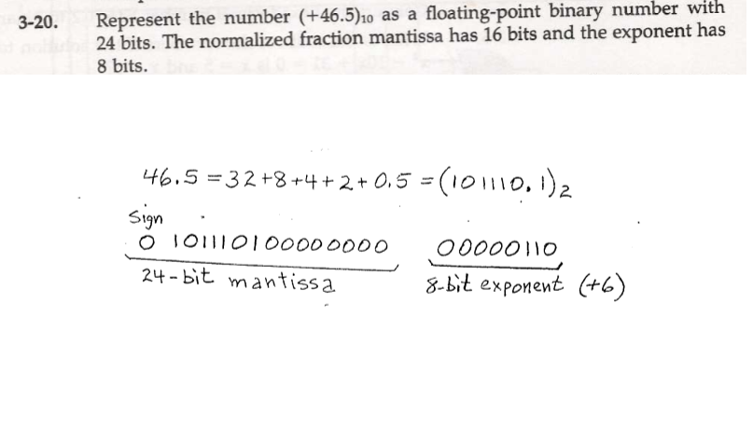

Slide 28
Thanks

